Slide 1


.NET 7 and C# 11
What’s new?
Author: Vu.Truong
Source: Github
Dec/2022

Slide 2


TABLE OF CONTENTS
01.
04.
06.
.NET 7
Entity Framework 7
Demo
02.
05.
C# 11
Other updates
03.
ASP.NET Core 7

Slide 3
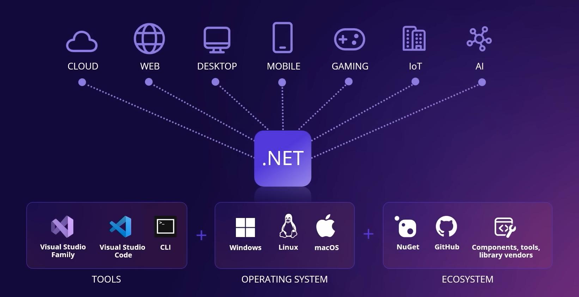

Slide 4


.NET 7
What’s new?

Slide 5
.NET 7 - What’s new?
Performance improvements
Linq
Native AOT
Reflection
System.Text.Json
Generic Math
Built-in container support
Notes:
https://learn.microsoft.com/en-us/dotnet/core/deploying/native-aot/
https://learn.microsoft.com/en-us/dotnet/core/extensions/http-ratelimiter
https://devblogs.microsoft.com/dotnet/system-text-json-in-dotnet-7/
C# Hot Reload feature will be present in Blazor WebAssembly and .NET for iOS and Android.
In addition, Microsoft includes new features such as:
Adding static lambdas to existing methods
Adding lambdas that capture this to existing methods that already have at least one lambda that captures this
Adding new static or non-virtual instance methods to existing classes
Adding new static fields to existing classes
Adding new classes
Observability: OpenTelemetry
Adding Microseconds and Nanoseconds to TimeStamp, DateTime, DateTimeOffset, and TimeOnly
Introducing Activity.Current change event

Slide 6
.NET 7 - What’s new?
.NET Libraries
P/Invoke source generation
Hot reload improvements
Tar File APIs
gRPC JSON transcoding
Regular expressions
Observability
Copy UTF-8 & UTF-16 Strings
New Roslyn analyzer and fixer for RegexGenerator
OSR, Tiered PGO improvement
Notes:
https://learn.microsoft.com/en-us/dotnet/core/deploying/native-aot/
https://learn.microsoft.com/en-us/dotnet/core/extensions/http-ratelimiter
https://devblogs.microsoft.com/dotnet/system-text-json-in-dotnet-7/
C# Hot Reload feature will be present in Blazor WebAssembly and .NET for iOS and Android.
In addition, Microsoft includes new features such as:
Adding static lambdas to existing methods
Adding lambdas that capture this to existing methods that already have at least one lambda that captures this
Adding new static or non-virtual instance methods to existing classes
Adding new static fields to existing classes
Adding new classes
Observability: OpenTelemetry
Adding Microseconds and Nanoseconds to TimeStamp, DateTime, DateTimeOffset, and TimeOnly
Introducing Activity.Current change event
https://devblogs.microsoft.com/dotnet/announcing-dotnet-7-preview-4/#added-new-tar-apis
PGO: https://gist.github.com/EgorBo/dc181796683da3d905a5295bfd3dd95b

Slide 7
.NET 7 - Performance
https://devblogs.microsoft.com/dotnet/performance_improvements_in_net_7
Notes:
https://learn.microsoft.com/en-us/dotnet/core/deploying/native-aot/
https://learn.microsoft.com/en-us/dotnet/core/extensions/http-ratelimiter

Slide 8
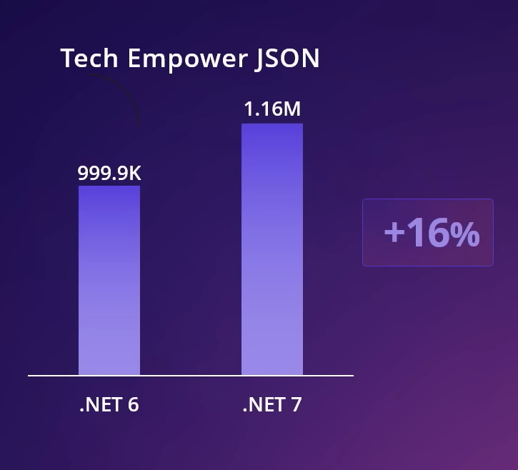
.NET 7 - API Performance
Focus on
Plain text: 8% more RPS
JSON: 16% more RPS
Notes:
https://learn.microsoft.com/en-us/dotnet/core/deploying/native-aot/
https://learn.microsoft.com/en-us/dotnet/core/extensions/http-ratelimiter

Slide 9
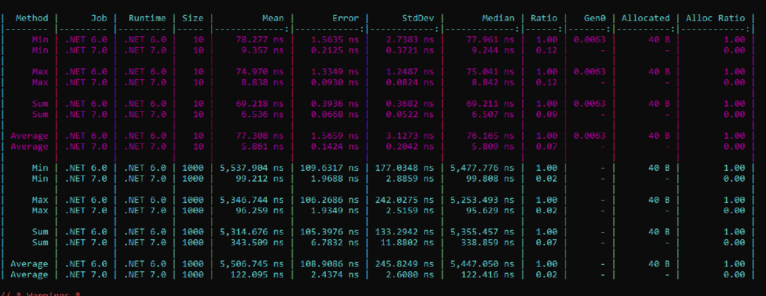
Linq
Linq method improvements:
Notes:
https://learn.microsoft.com/en-us/dotnet/core/deploying/native-aot/
https://learn.microsoft.com/en-us/dotnet/core/extensions/http-ratelimiter

Slide 10
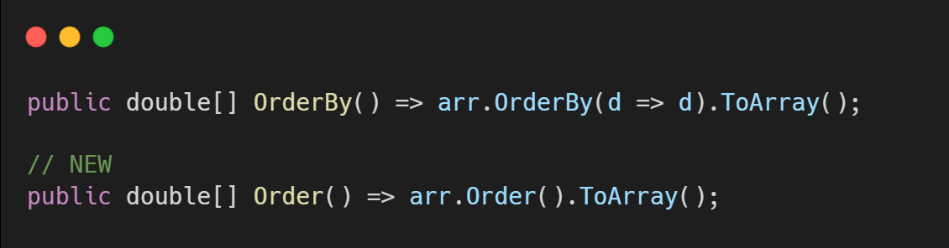
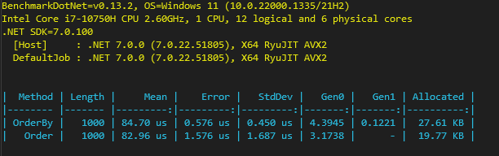
Linq
New Order method
System.Collections.Generic.IComparer<T>
Notes:
https://learn.microsoft.com/en-us/dotnet/core/deploying/native-aot/
https://learn.microsoft.com/en-us/dotnet/core/extensions/http-ratelimiter

Slide 11
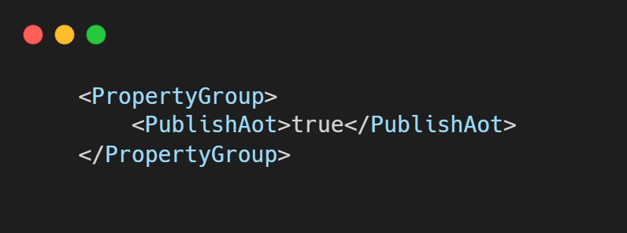
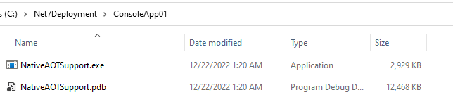
Native AOT
Notes:
https://learn.microsoft.com/en-us/dotnet/core/deploying/native-aot

Slide 12
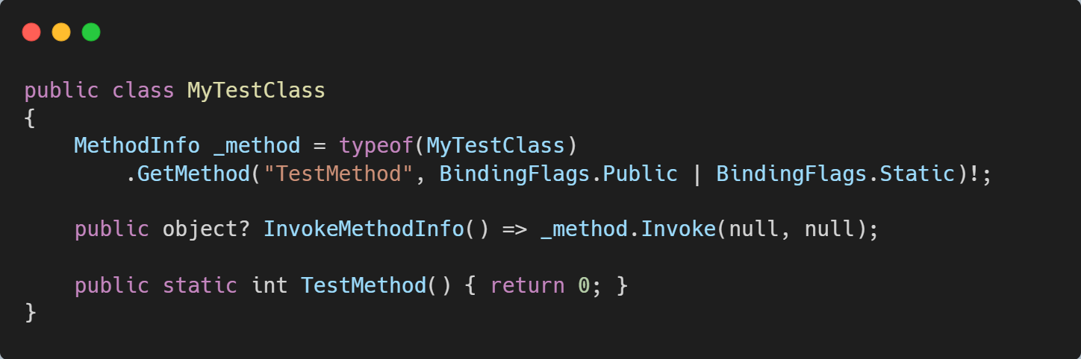
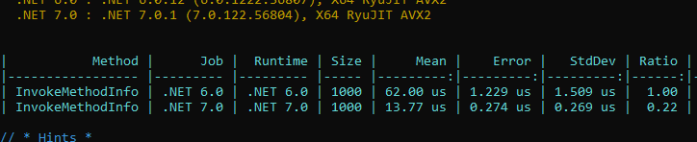
Reflection
Notes:
https://devblogs.microsoft.com/dotnet/announcing-dotnet-7-preview-5/#system-reflection-performance-improvements-when-invoking-members

Slide 13
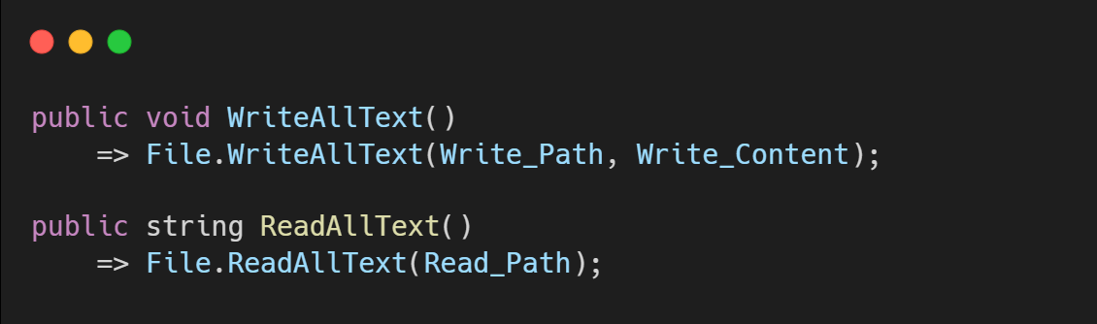
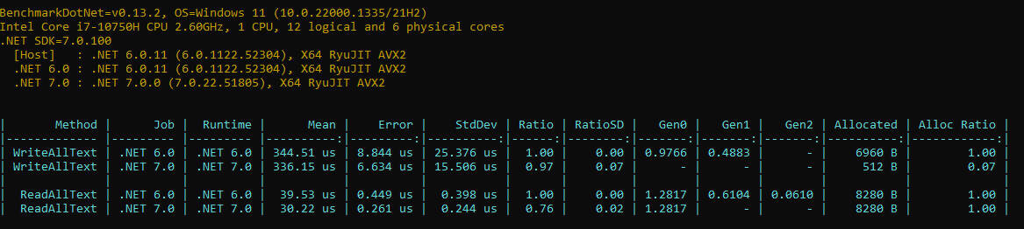
System.IO
Notes:
https://learn.microsoft.com/en-us/dotnet/core/deploying/native-aot/
https://learn.microsoft.com/en-us/dotnet/core/extensions/http-ratelimiter

Slide 14
C#11

Slide 15
C# 11
Static Virtual Member in Interface
Generic Math support
Generic Attributes
String Literals
UTF-8 string literals
New line in interpolations
File-local types
List patterns
Pattern match Span
Required members
Auto-default structs
Extened nameof scope
Improved Method group conversion
Numeric IntPtr and UIntPtr
ref fields and ref scoped variables
Notes:
https://github.com/dotnet/csharplang/blob/main/proposals/csharp-11.0/low-level-struct-improvements.md
https://learn.microsoft.com/en-us/archive/msdn-magazine/2018/january/csharp-all-about-span-exploring-a-new-net-mainstay
There is another type called Memory<T>, which is very similar to Span<T>, but it is a plain, old struct without the ref keyword, so it can be a field of a type, it can be used in async methods, and so on.

Slide 16
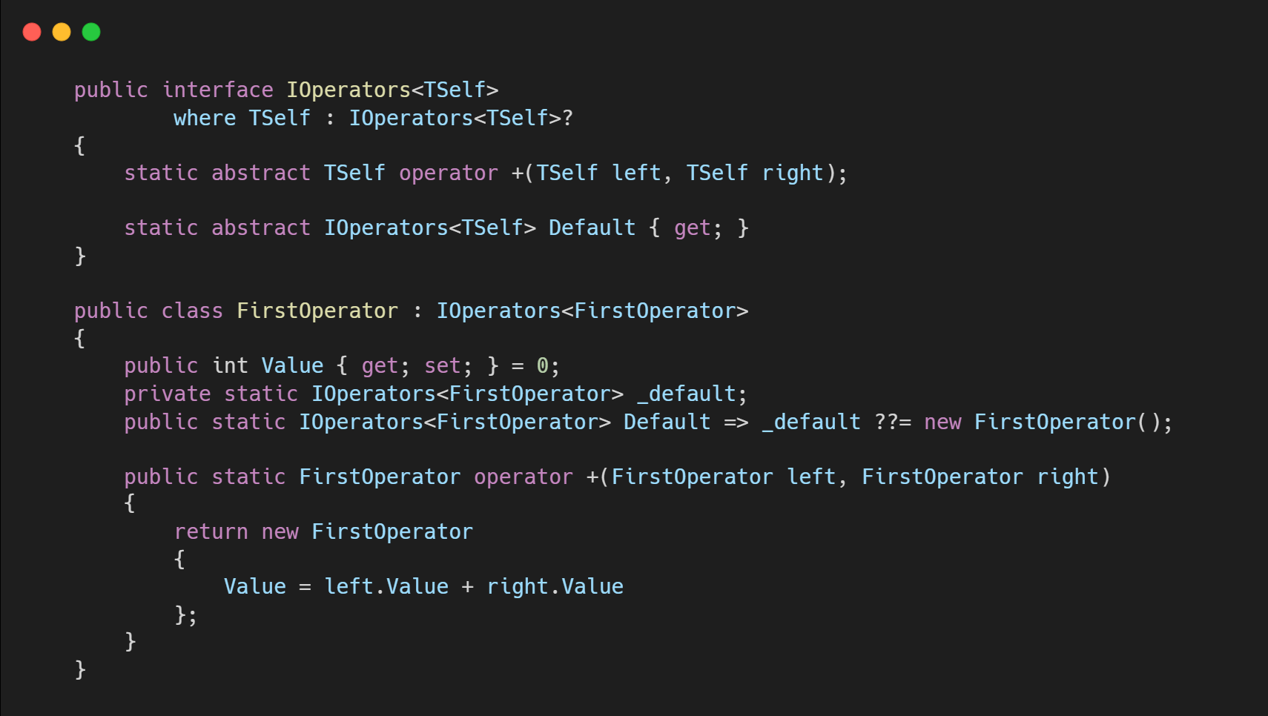
Static Virtual Member in Interface
This feature enables you to define interfaces that include overloaded operators or other static members.

Slide 17
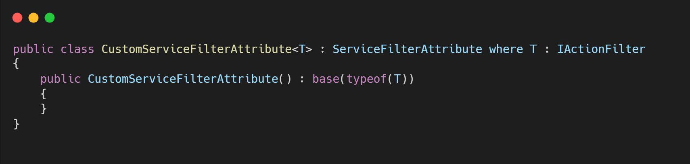
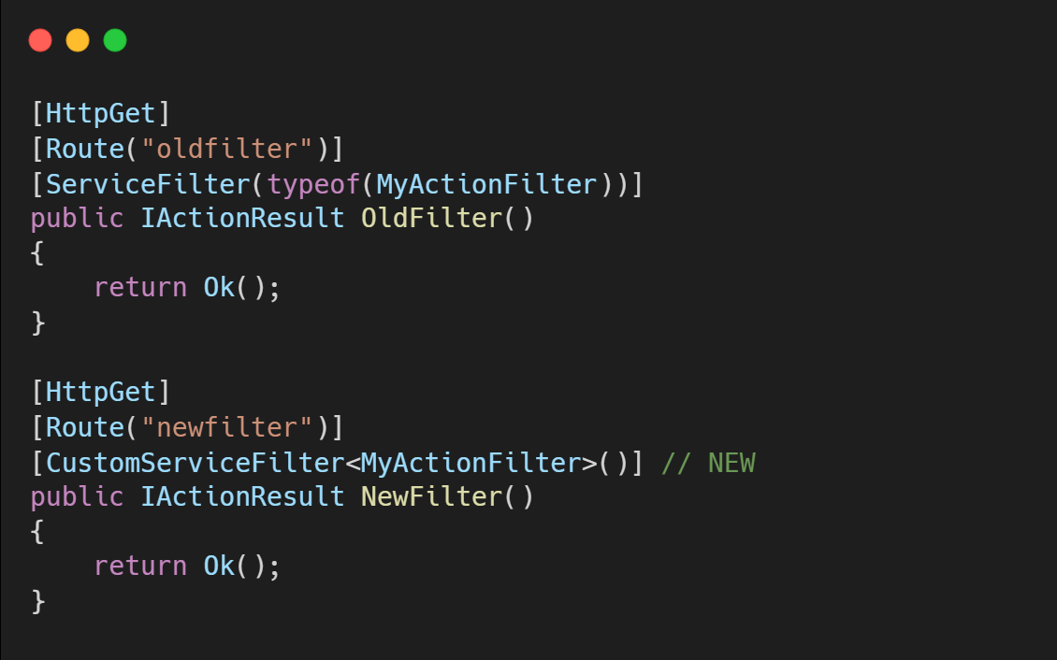
Generic Attributes

Slide 18
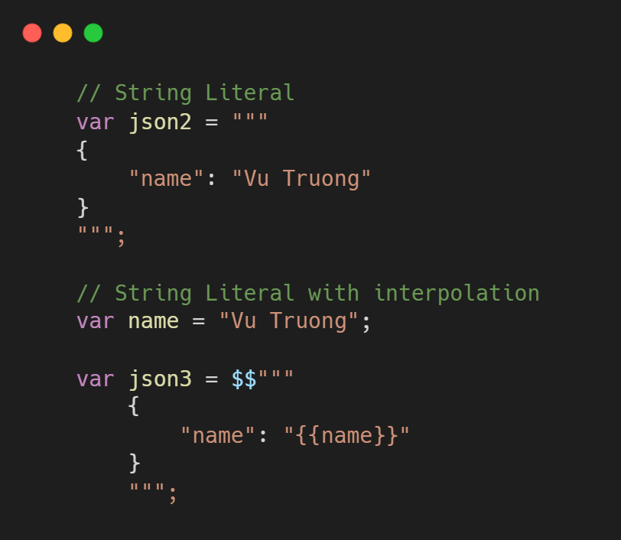
String Literals

Slide 19
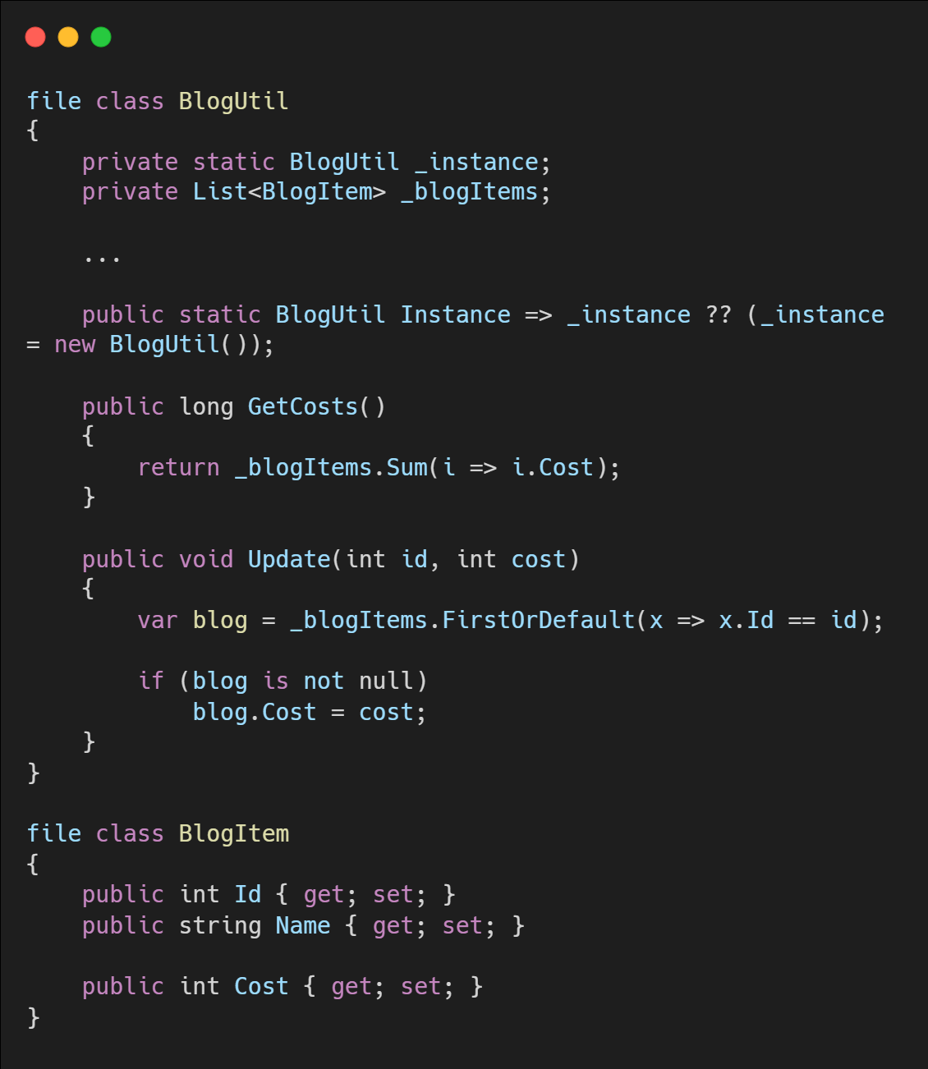
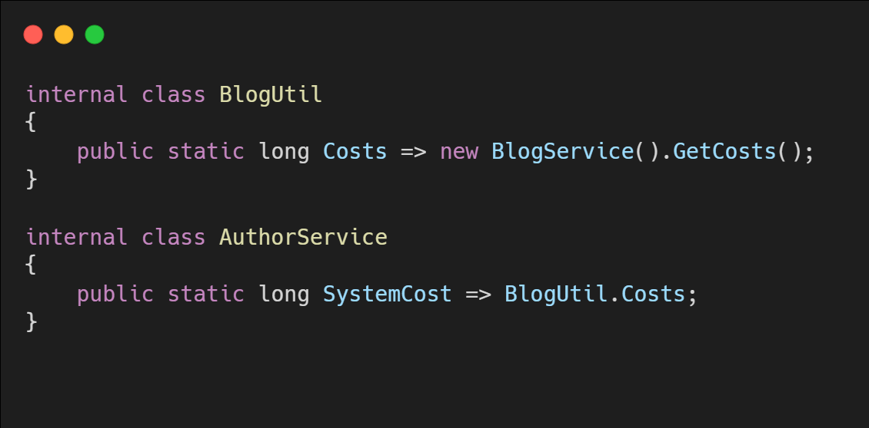
File-local Type
File A.cs
File B.cs

Slide 20
ASP.NET Core 7

Slide 21
ASP.NET Core 7
Rate limiting
Output caching middlewares
Default authentication scheme
Added metrics for Microsoft.Extensions.Caching
Parameter binding with DI in API controllers
Support for nullable models in MVC views and Razor Pages
New problem details service

Slide 22
ASP.NET Core 7
Kestrel performance improvements
Improve console out for dotnet watch
Developer exception page dark mode
Updated Angular and React templates
Option to use Program.Main method instead of top-level statements
Request decompression
HTTP/3 Improvements
HTTP/2 Performance improvements
HTTP/2 WebSockets support

Slide 23
Rate Limiter
Rate limiting is the concept of limiting how much a resource can be accessed
Fixed window
Sliding window
Token bucket
Concurrency
Notes:
https://learn.microsoft.com/en-us/dotnet/core/extensions/http-ratelimiter
https://devblogs.microsoft.com/dotnet/announcing-rate-limiting-for-dotnet/
https://learn.microsoft.com/en-us/aspnet/core/performance/rate-limit?preserve-view=true&view=aspnetcore-7.0

Slide 24
Output Cache
The output caching middleware enables caching of HTTP responses
The caching behavior is configurable on the server
The cache storage medium is extensible
You can programmatically invalidate selected cache entries
Resource locking mitigates the risk of cache stampede and thundering herd
Cache revalidation minimizes bandwidth usage
Notes:
https://learn.microsoft.com/en-us/aspnet/core/performance/caching/overview?view=aspnetcore-7.0#output-caching

Slide 25
ASP.NET Core 7
Blazor
Web Assembly Experimental
Custom Elements
Hot Reload Improvements
System.Security.Cryptography support on WebAssembly
Experimental QuickGrid component
@bind enhancement
New Blazor loading page
gRPC
RESTful HTTP APIs for gRPC
Built-in support for health checks
Call Credentials
Minimal APIs
Group Routes
Open API improvements
Provide endpoint descriptions and summaries
Filters
Typed Results
File Uploads
New Results.Stream overloads
New HttpResult interfaces
SignalR
Requesting client results
DI for SignalR hub methods

Slide 26
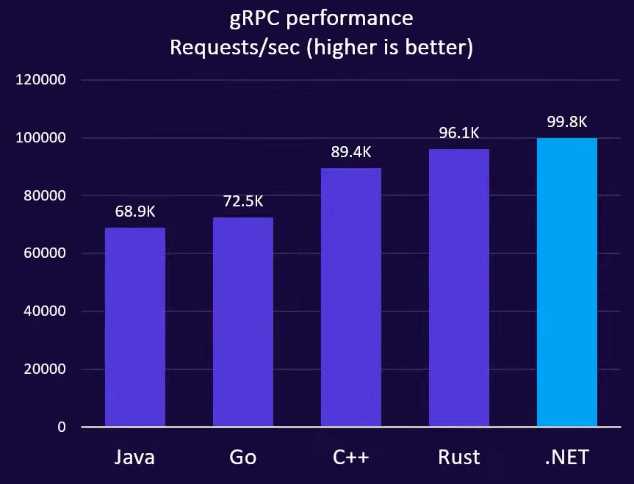
gRPC Performance
HTTP/2 re-architecture
Significant concurrency improvements
Server streaming:
.NET 6 - 0.5 ms RPS
.NET 7 - 4.5 ms RPS (8x increase)
Upload speed: 108mb upload with latency
.NET 6 - 26.9s
.NET 7 - 4.3s ( 6x faster)
Source: https://github.com/LesnyRumcajs/grpc_bench

Slide 27
Entity Framework 7

Slide 28
Entity Framework 7
JSON Columns
ExecuteUpdate and ExecuteDelete (Bulk updates)
Faster Savechanges
Table-per-concrete-type (TPC) inheritance mapping
Model building conventions
Model building enhancements
Stored procedure mapping
Custom Reverse Engineering Templates
New and improved interceptors and events
Query Enhancements
DbContext API and behavior enhancements
Improved value generation
Migrations tooling improvements
Performance enhancements for proxies
First-class Windows Forms data binding
Notes:
https://learn.microsoft.com/en-us/ef/core/what-is-new/ef-core-7.0/whatsnew
https://learn.microsoft.com/en-us/ef/core/managing-schemas/scaffolding/templates?tabs=dotnet-core-cli

Slide 29
Other updates

Slide 30
Other updates
F# 11
Announcing F# 7
.NET MAUI
What's new?
Windows Forms
What's new?
WPF
What's new?
.NET Upgrade Assistant and CoreWCF
ML.NET
What's new?
Introducing the ML.NET Text Classification API (preview)
Orleans
What's new?
Notes:
https://devblogs.microsoft.com/dotnet/use-net-7-from-any-javascript-app-in-net-7/

Slide 31
Q & A

Slide 32
References
https://learn.microsoft.com/en-us/dotnet/core/compatibility/7.0
https://learn.microsoft.com/en-us/dotnet/whats-new/dotnet-7-docs
https://devblogs.microsoft.com/dotnet/system-text-json-in-dotnet-7/
https://learn.microsoft.com/en-us/dotnet/csharp/whats-new/tutorials/static-virtual-interface-members
https://devblogs.microsoft.com/dotnet/announcing-dotnet-7-preview-5/#analyzer
https://learn.microsoft.com/en-us/aspnet/core/release-notes/aspnetcore-7.0?view=aspnetcore-7.0
https://learn.microsoft.com/en-us/aspnet/core/performance/rate-limit?preserve-view=true&view=aspnetcore-7.0
https://learn.microsoft.com/en-us/aspnet/core/fundamentals/middleware/request-decompression?preserve-view=true&view=aspnetcore-7.0
https://learn.microsoft.com/en-us/aspnet/core/performance/caching/overview?view=aspnetcore-7.0#output-caching
https://learn.microsoft.com/en-us/dotnet/standard/memory-and-spans/memory-t-usage-guidelines

Slide 33

THANK YOU!

